Slide 1
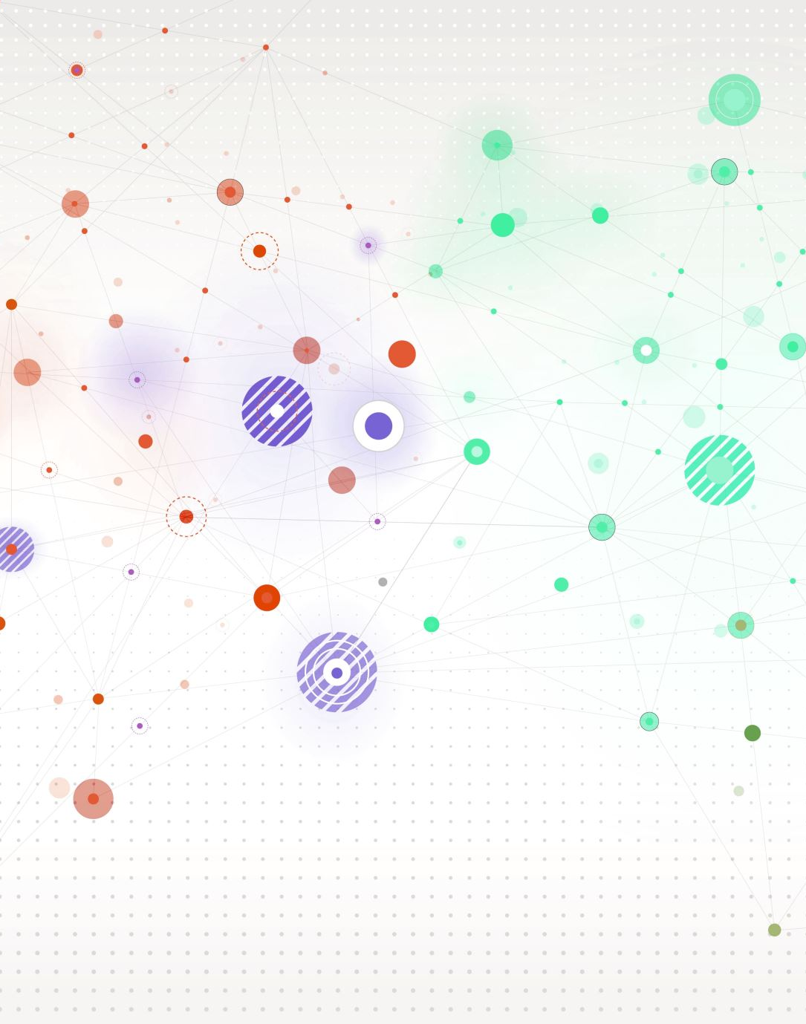
CSS Animations

Slide 2
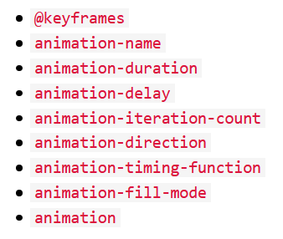
CSS Animation
Allows user to animate without using JS or Flash.

Slide 3
@keyframe Rule
When specified, the animation will gradually change from current style to the new style at certain times.
To get the animation to work, we have to bind the animation to an element.

Slide 4
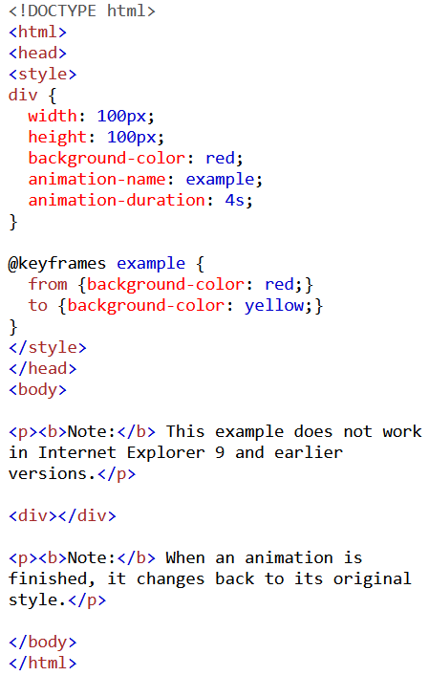
Example

Slide 5
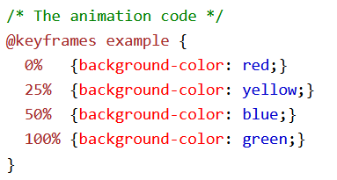
Example
We can further specify the transition using percentage of time spent e.g.

Slide 6
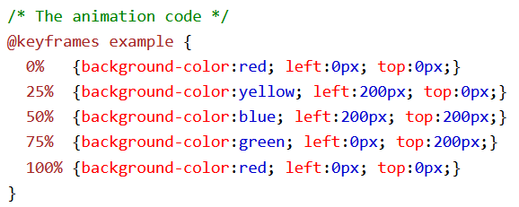
Example
We can even change the position of the element, other that its colour. E.g.

Slide 7
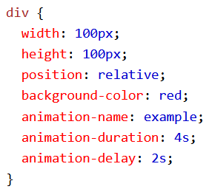
Example
We can also delay using animation-delay

Slide 8
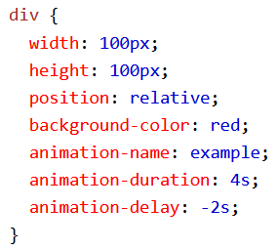
Example
Starting an animation after playing it for N seconds

Slide 9
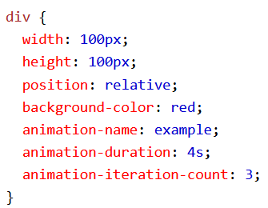
Example
Telling the browser how may times the animation should run
Notes:
Infinite iteration count?

Slide 10
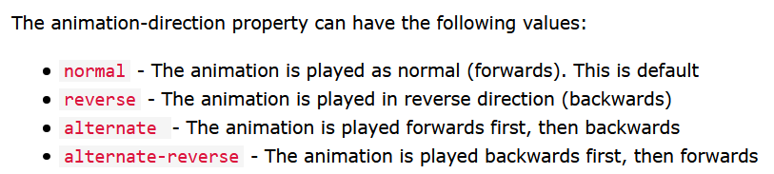
Example
Using animation-direction to specify the direction at which the animation is played.

Slide 11
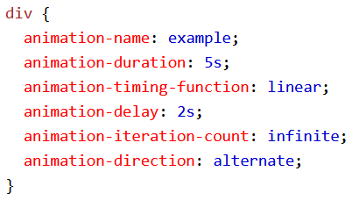

Example
Animation shorthand
See top-right vs bottom-right

Slide 12
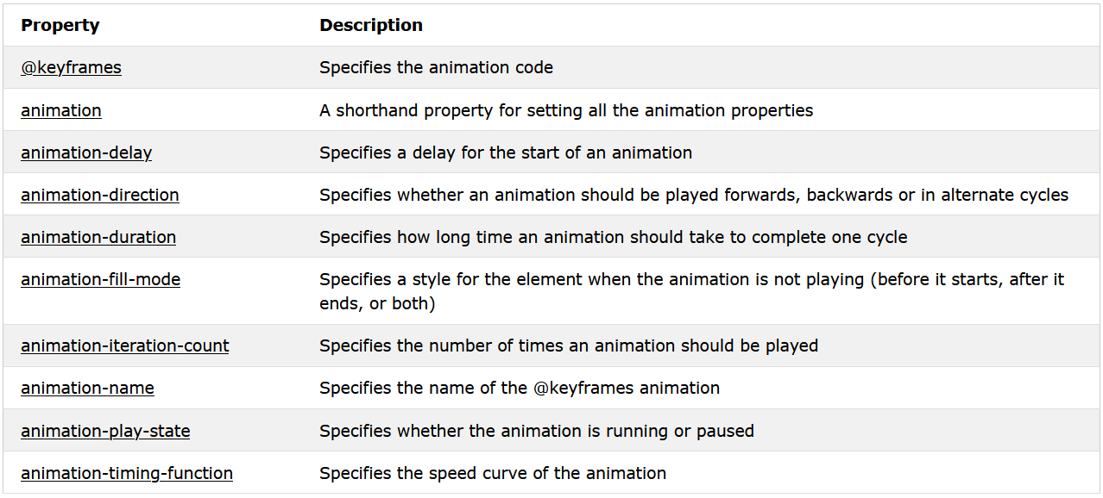
Summary

Slide 13
Example
Create a Bounce-In effect animation

